Slide 1

Auto-ML (Automated Machine Learning)
Presented by
M.Mohana

Slide 2
What is AutoML?
Process of automating the end-to-end process of applying machine learning algorithms to real-world problems.
Automation includes tasks such as data preprocessing, feature engineering, model selection, hyperparameter tuning, and model evaluation
Aims to make machine learning more accessible to non-experts and accelerate the development of machine learning applications by automating repetitive and time-consuming tasks

Slide 3
Components of AutoML
Data Preprocessing: asks like handling missing values, encoding categorical variables, scaling features, and splitting data into training and validation sets.
Feature Engineering: Automatic generation or selection of relevant features to improve model performance.
Model Selection: Choosing the most appropriate machine learning algorithms based on the dataset and problem type.
Hyperparameter Tuning: Optimizing model hyperparameters to achieve better performance.
Model Evaluation: Assessing model performance using metrics like accuracy, precision, recall, F1-score, etc.

Slide 4
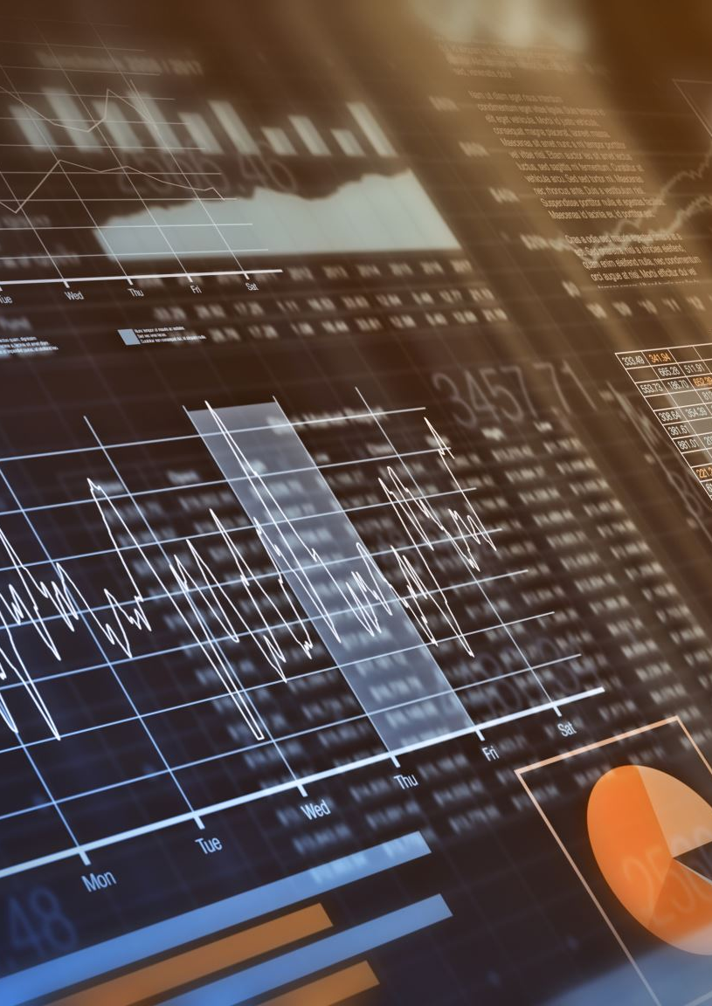
AutoML for Different Data Types
Used to perform a wide range of machine learning tasks, including classification, regression, clustering, deep learning, and even forecasting, Computer Vision
Tabular Data: Classification and Regression
Can be used also be used for Time Series Forecasting, by automatically exploring and evaluating multiple time series forecasting algorithms including traditional methods like ARIMA (AutoRegressive Integrated Moving Average).
Image Data: Computer Vision
Process of selecting the most suitable model architectures for image recognition tasks.
Text Data: Natural Language Processing (NLP)
Process of extracting meaningful insights from text data, eliminating the need for manual feature engineering analyzing linguistic patterns, relationships, and structures within the text, and facilitating the extraction of relevant information.

Slide 5

Benefits of AutoML
Time Efficiency
Reduces the time required for manual model development and optimization.
Accessibility
Enables non-experts to leverage machine learning techniques without extensive knowledge.
Consistency
Ensures consistent application of best practices across different projects.
Scalability
Facilitates the handling of large datasets and complex models.
Optimization
Automatically tunes hyperparameters to improve model performance.
https://www.geeksforgeeks.org/what-is-automl-in-machine-learning/

Slide 6

Top AutoML tools and platforms
Google AutoML
H2O.ai
Auto-sklearn
TPOT
Microsoft Azure AutoML
Databricks AutoML
TIBCO Data Science
AutoKeras
Auto-PyTorch
Amazon Lex
AutoGluon
AutoWEKA
https://www.run.ai/guides/automl

Slide 7

Challenges of AutoML
Black Box Models
Automated processes may result in complex models that are challenging to interpret.
Limited Customization
Some AutoML tools may have limited flexibility compared to manual model development.
Domain Knowledge
Understanding domain-specific requirements and nuances is still crucial.
Data Quality
AutoML performance heavily depends on the quality and cleanliness of the input data.
Overfitting
Automated processes may lead to overfitting if not properly controlled.

Slide 8
Auto Keras
AutoKeras is an open-source AutoML (Automated Machine Learning) library built on TensorFlow and developed by the Data Analytics and Decision Support Lab (DADS) at Texas A&M University.
Simplify the process of building and training ML models by automating several key steps such as architecture search, hyperparameter tuning, and model selection.
Some key features of AutoKeras include:
AutoKeras uses neural architecture search (NAS) techniques to automatically search for the best neural network architecture for a given dataset and task.
Automates the process of hyperparameter tuning, such as learning rates, batch sizes, and activation functions, to improve model performance.
AutoKeras provides a user-friendly API that allows developers and data scientists to quickly build and train machine learning models without extensive manual configuration.
Supports various machine learning tasks, including classification, regression, image classification, text classification, and structured data prediction.
Since AutoKeras is built on top of TensorFlow, it seamlessly integrates with other TensorFlow tools and libraries, making it easy to incorporate into existing TensorFlow workflows.

Slide 9
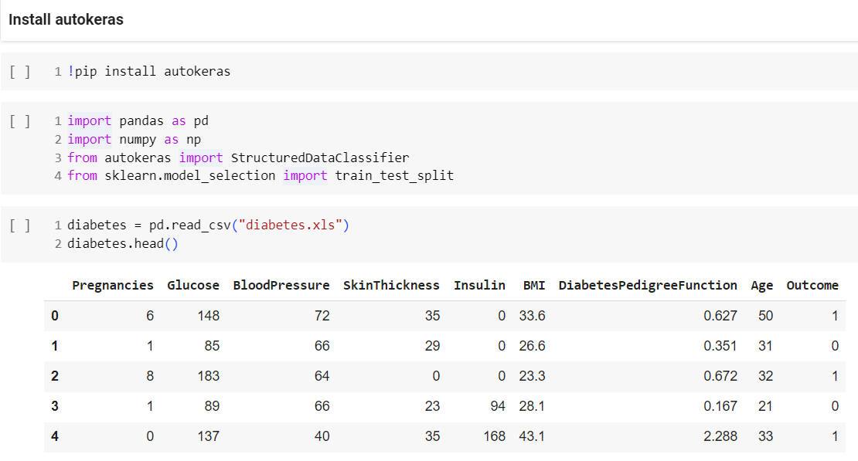

Slide 10
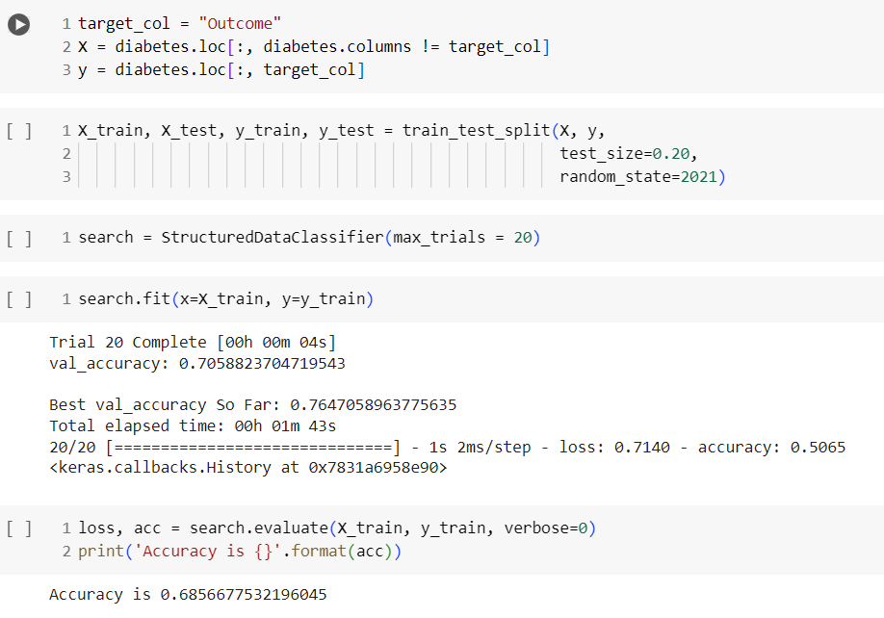

Slide 11
Thank you..! Keep Learning..!

